Slide 1

Analyzing
characteristics of users
from MoMo Loyalty Program
Tên: Phạm Quốc Huy
Mentor: Nguyễn Thị Thắm
Lớp/Nhóm: DA18/Nhóm 2

Slide 2
TABLE OF CONTENTS
Intro
Data
Customer Segmentation
Scale Data
Find K
Modeling KMeans
01
02
03
04
05
06
07
Cluster Analysis
08
Conclusison

Slide 3


Introduction
1.1. Problem
1.2. My approaches

Slide 4
Introduction
1.1. Problem
Users' retention has always been one of the key targets that MoMo is striving to be better. A Loyalty program called "MoMo Hoàn Tiền" - one of the projects aiming to achieve such goal was launched from January 1st 2021 to March 2022.
What ideas do you have for MoMo in loyalty program development strategy?
Do you have any advice for the Marketing department in designing promotion campaigns to increase user retention's performance?

Slide 5
Introduction
1.2. Approaches
Using Machine Learning model KMeans to find clusters in by analyzing RFM.
Find characteristics and true needs of users to offer the right service.
Recency (R): How recently a customer has made a transaction
Frequency (F): How often a customer makes a transaction
Monetary Value (M): Money value of the transaction

Slide 6
2. Data
2.1. Data
2.2. Data Processing
2.3. EDA

Slide 7
2. Data
2.1. Data
Transaction
User_id | Order_id | Date | GMV | Service Group | Merchant_id
123 | 234 | 01-17-2020 | 100000 | supermarket | 12
... | ... | ... | ... | ... | ...
User_id: each user in MoMo will be given an unique id Order_id: each transaction will be given an unique id Date: date on which the transaction takes place GMV (Gross Merchandise Value): total amount of money that user spends (VND) Service Group: group services that users spend on Merchant_id: each merchant will be given a unique id
Merchant
ServiceID | Service Group | Merchant | MerchantID
7eleven | cvs | 7eleven | 1
MOMOIOQC20191008 | cvs | 7eleven | 1
Service_id: each service group will be given an unique id Order_id: each transaction will be given an unique id Merchant: merchant services that users spend on Merchant_id: each merchant will be given a unique id

Slide 8
2. Data
2.2. Data Processing
# | Column | Non-null | Count | Dtype
0 | DATE | 58158 | non-null | datetime64
1 | Order_id | 58158 | non-null | int64
2 | NEWVERTICAL_Merchant | 58158 | non-null | object
3 | MerchantID | 58158 | non-null | int64
4 | User_id | 58158 | non-null | int64
5 | GMV | 58158 | non-null | int64
6 | Service Group | 58158 | non-null | object
7 | ServiceID | 58158 | non-null | object
8 | Merchant | 58158 | non-null | object
Steps:
Deleted nulls
Dropped duplicates
Lowercased
Merged two dataframes

Slide 9
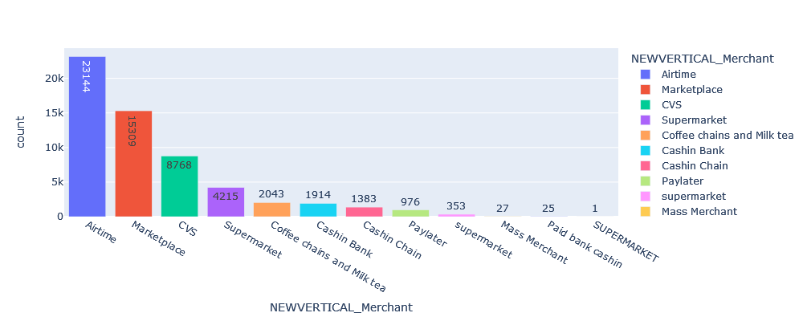
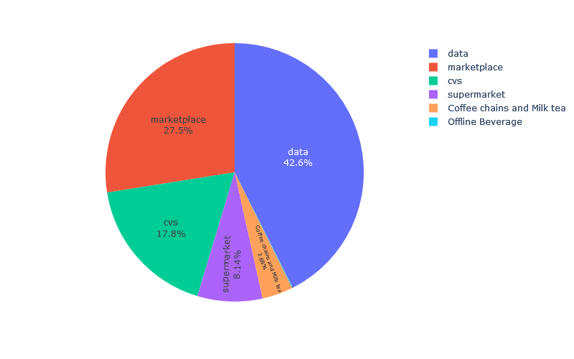
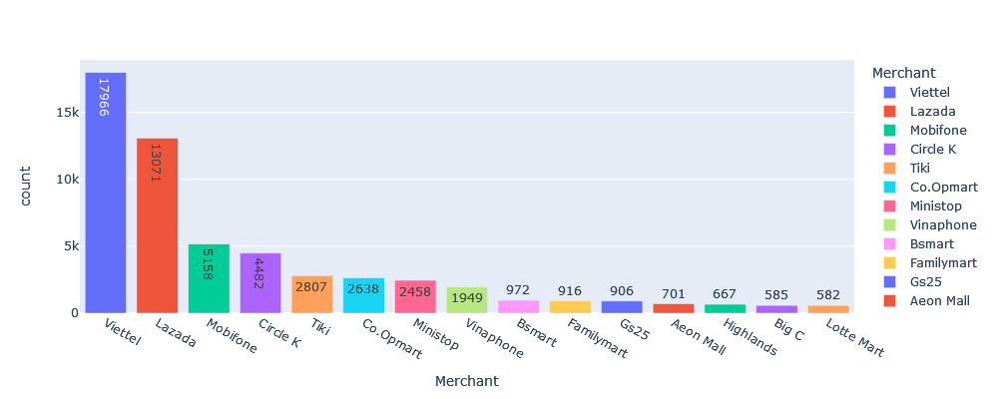
2. Data
2.3. EDA
Service Group
Notes:
Airtime: mobile card, data 4G, gift_card …

Slide 10
3. Customer
Segmentation
3.1. RFM

Slide 11
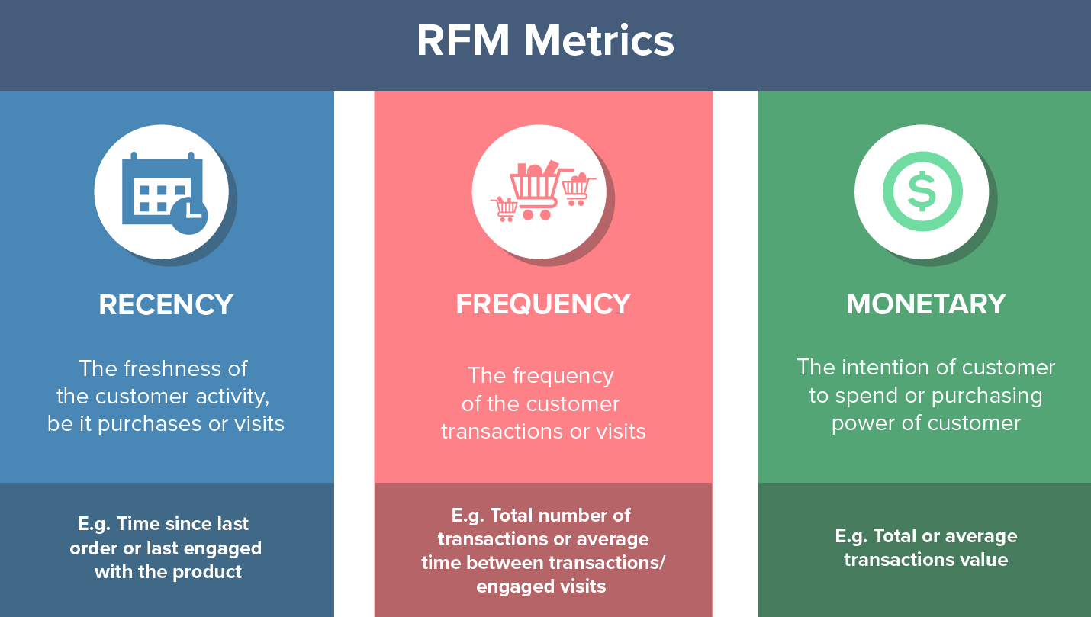
3. Customer Segmentation
3.1. RFM
User_id | Recency | Frequency | Monetary_Value
61386143 | 36 | 49 | 2904300
61267321 | 33 | 524 | 86239904
7367023 | 443 | 6 | 1274000
61488523 | 450 | 175 | 14680000
37269379 | 450 | 172 | 17180000
… | … | … | …

Slide 12
4. Feature Engineering
4.1. Transform Data
4.2. Scale Data

Slide 13
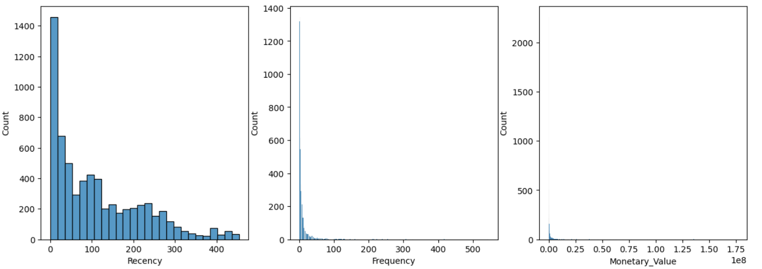
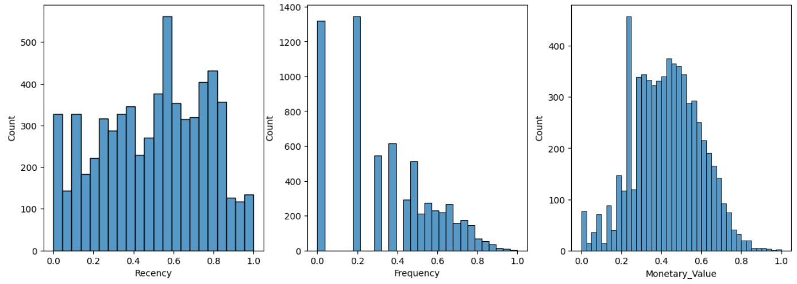
4. Scale Data
4.1. Transform Data
From this subplots, our data is skewed to the left, meaning it is not distributed well.
So we need to transform and scale the data
4.2 Scale Data
This is the distribution of RFM after using:
Box-Cox & Log Transformation
Min-max Scaler

Slide 14
5. Find K
5.1 Find K with Elbow, Silhouette
5.2 Find K using KneeLocator
5.3 Find K using KElbowVisualizer

Slide 15
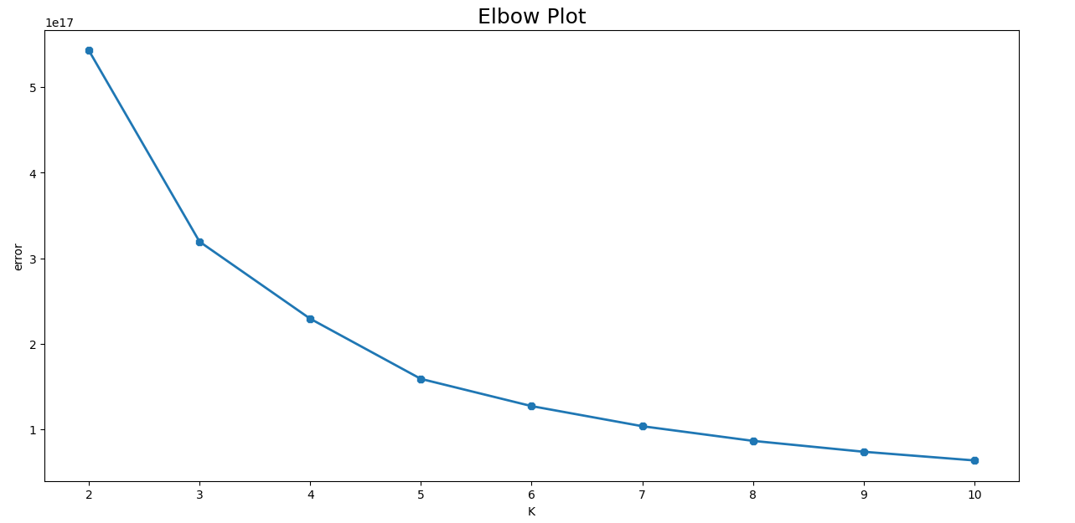
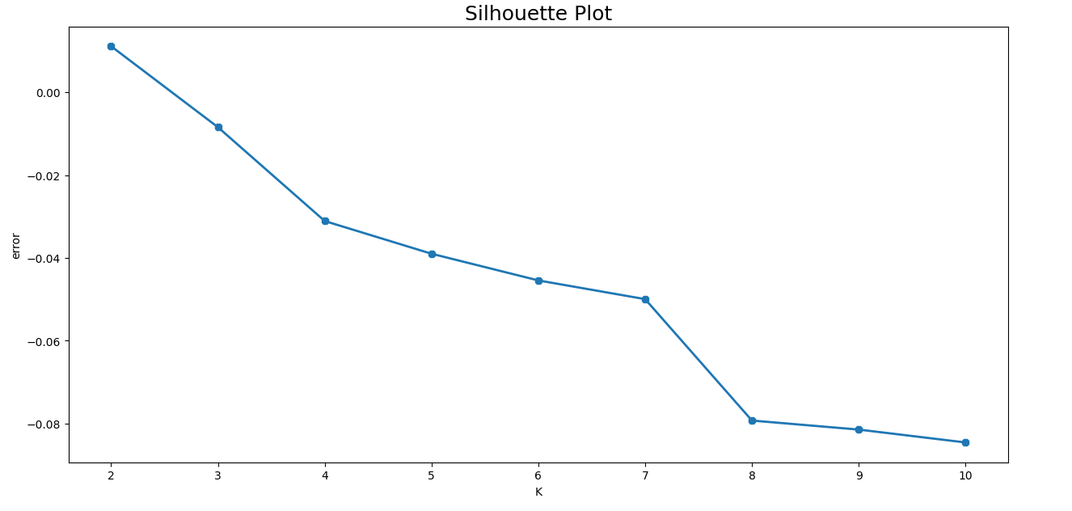
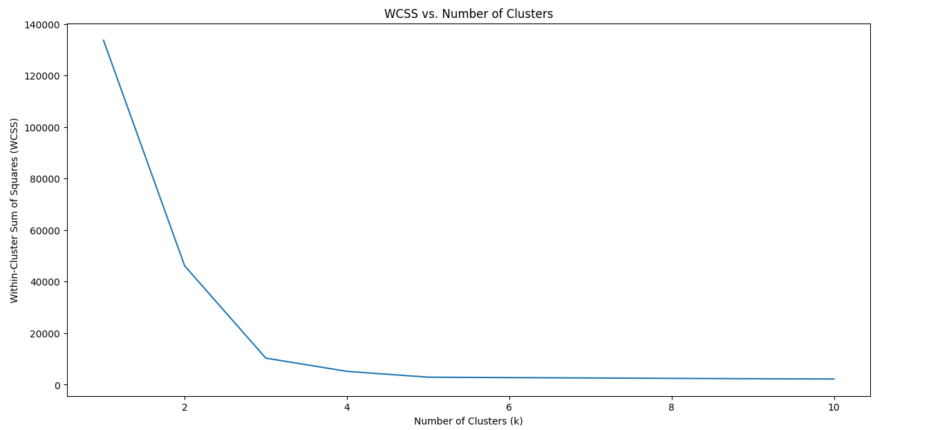
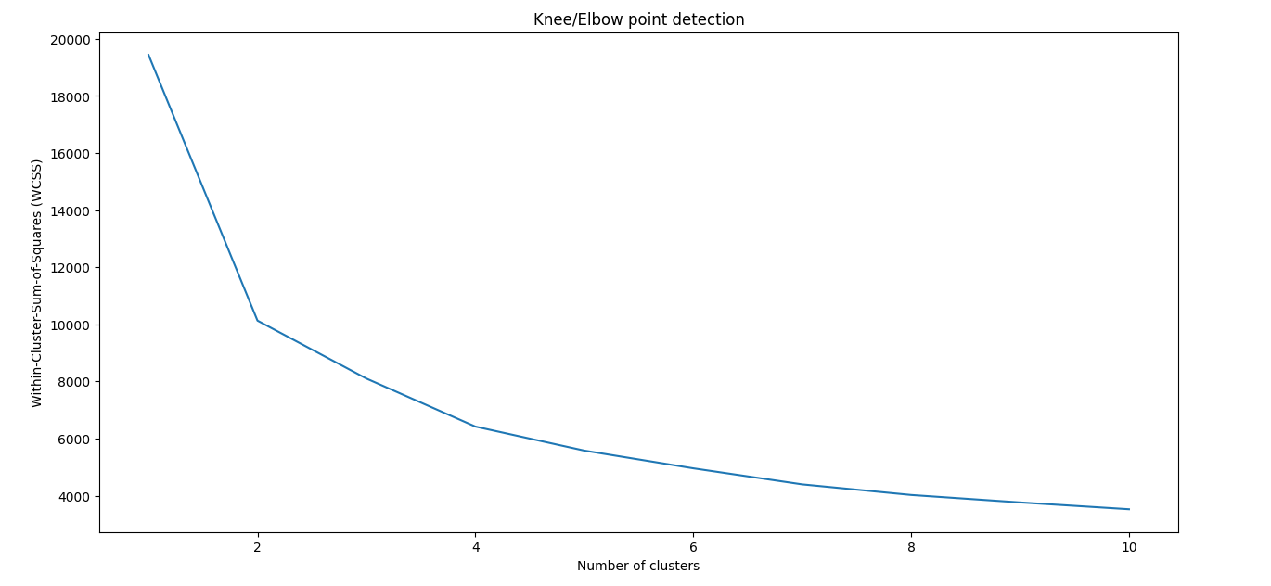
5. Find K
5.1 Find K with Elbow, Silhouette
5.2 Find K with WCSS KneeLocator

Slide 16
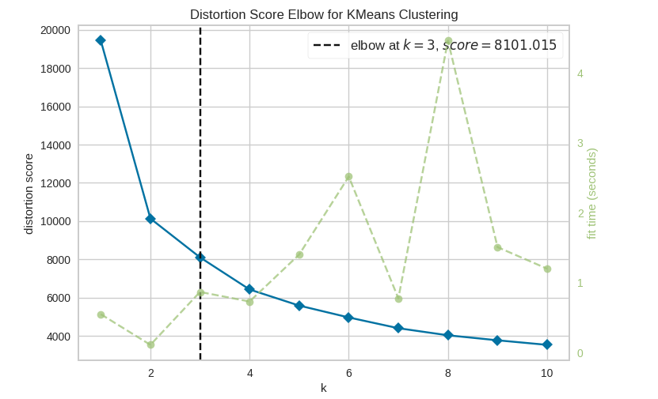
5. Find K
5.3 Find K with KElbow Visualizer
Uses the Elbow method.
Plots the within-cluster sum of squares (WCSS).
Identifies the "elbow" point where the WCSS curve starts to level off.
→ Choose K = 3

Slide 17
6. Modeling KMeans = 3
6.1. Applying clusters

Slide 18
6. Modeling KMeans = 3
6.1. Applying clusters
DATE | Order_id | NEWVERTICAL_Merchant | MerchantID | User_id | GMV | Service Group | Merchant | Recency | Frequency | Monetary_Value | Cluster
2021-01-01 | 8733622706 | Marketplace | 37 | 61386143 | 100000 | marketplace | Tiki | 36 | 49 | 2904300 | 0
2021-01-03 | 8759351785 | Airtime | 41 | 61386143 | 10000 | data | Viettel | 36 | 49 | 2904300 | 0
2022-02-08 | 20747004308 | Coffee Chains And Milk Tea | 35 | 44018659 | 69000 | Coffee chains and Milk tea | The Coffee House | 51 | 3 | 207000 | 1
2022-03-06 | 21673509622 | Coffee Chains And Milk Tea | 35 | 48918259 | 45000 | Coffee chains and Milk tea | The Coffee House | 25 | 3 | 135000 | 2
… | … | … | … | … | … | … | … | … | … | … | …
Cluster | Count
0 | 2297
1 | 2473
2 | 1709

Slide 19
7.1. Average GMV of users in Clusters
7.2. Most common service groups & merchants of users
7. Cluster Analysis
7.3. Average recency and frequency of purchases
from users in Clusters
7.4. Average monetary value of purchases from users in Clusters

Slide 20
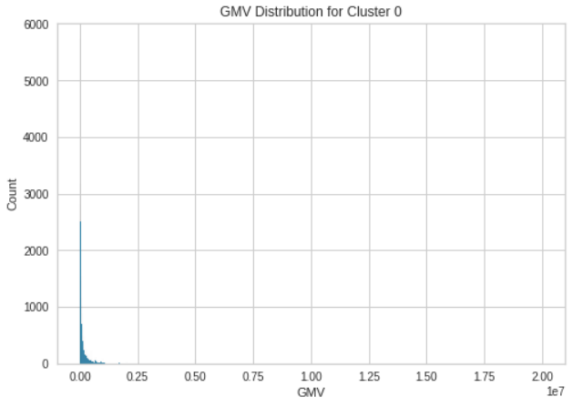
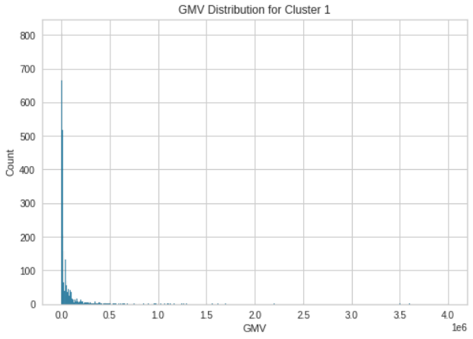
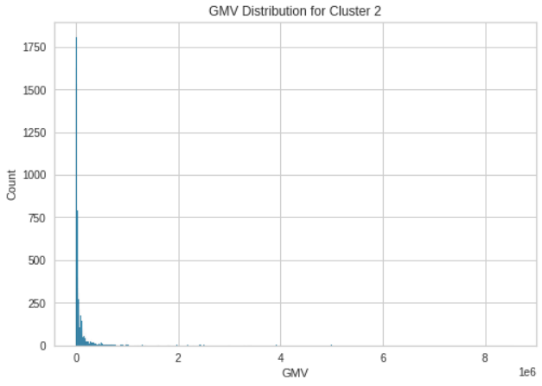
7. Cluster Analysis
7.1. Average GMV of users in Clusters
Observations:
Average GMV for Cluster 0: 122.457 VND
Average GMV for Cluster 1: 52.087 VND
Average GMV for Cluster 2: 157.749 VND

Slide 21
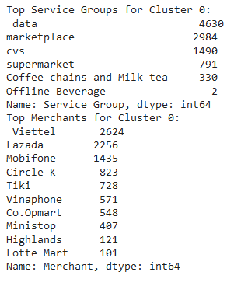
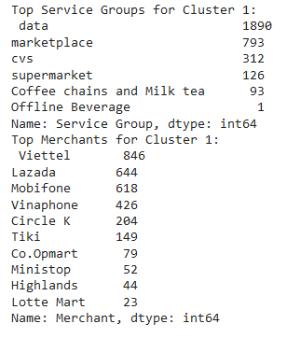
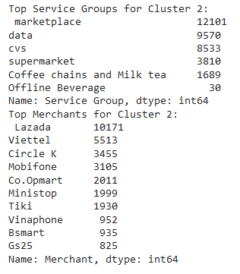
7. Cluster Analysis
7.2. Most common service groups & merchants of users
Cluster 0
Cluster 1
Cluster 2
Observations:
Top Service Groups for Cluster 0: Data, Marketplace, CVS, Supermarket, Coffee & Milk tea
Top Service Groups for Cluster 1: Data, Marketplace, CVS, Supermarket, Coffee & Milk tea
Top Service Groups for Cluster 2: Marketplace, Data, CVS, Supermarket ,Coffee & Milk tea

Slide 22
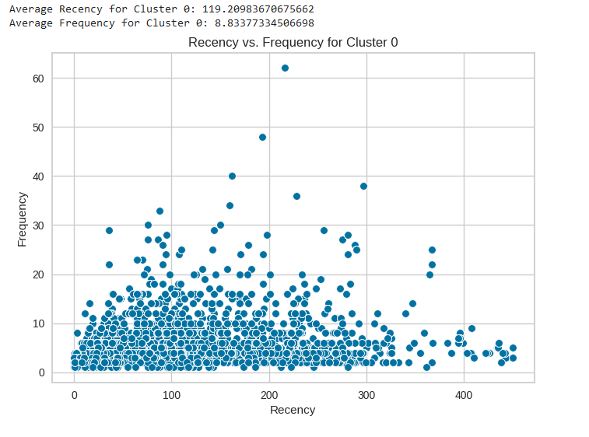
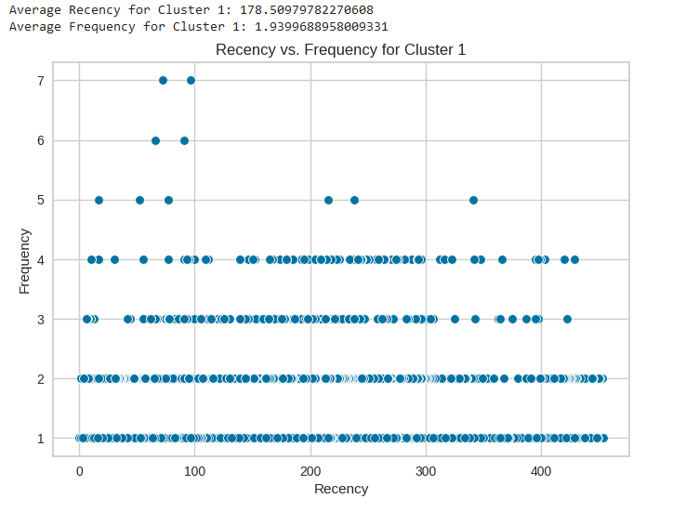
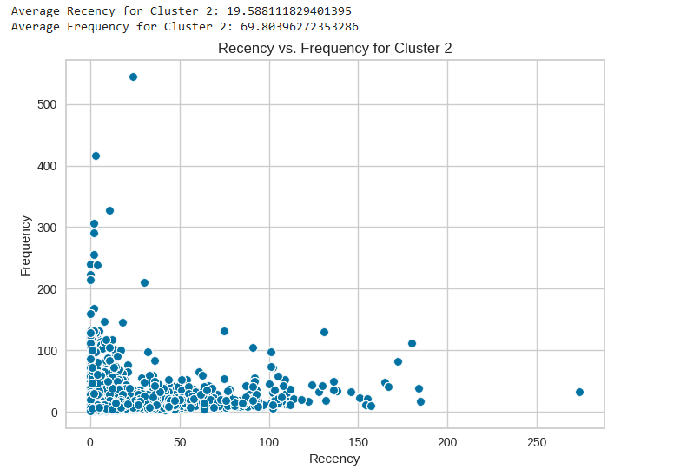
7. Cluster Analysis
7.3. Average recency and frequency of purchases from users in Clusters
Observations:
Average Recency, Frequency for Cluster 0: 119 & 9
Average Recency, Frequency for Cluster 1: 178 & 2
Average Recency, Frequency for Cluster 2: 19 & 69

Slide 23
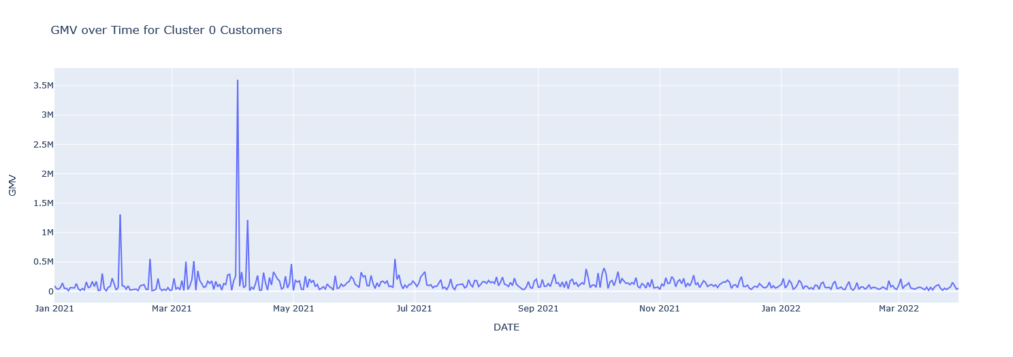
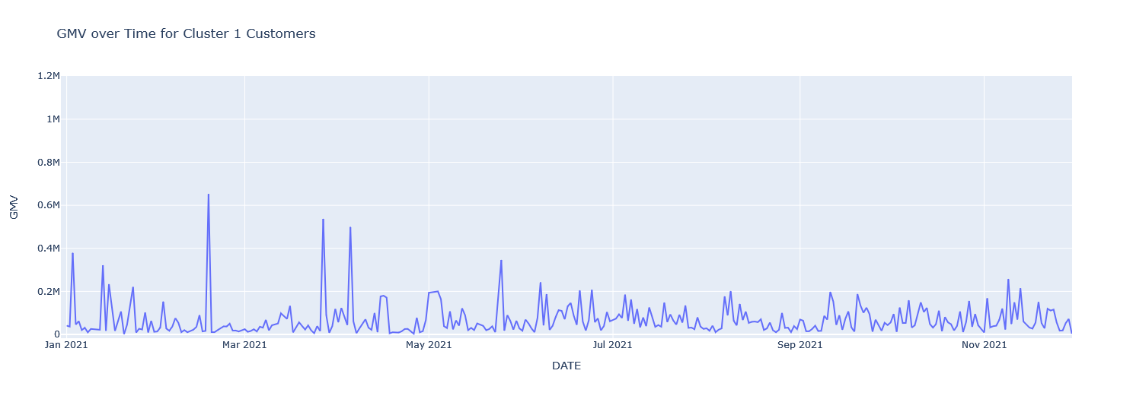
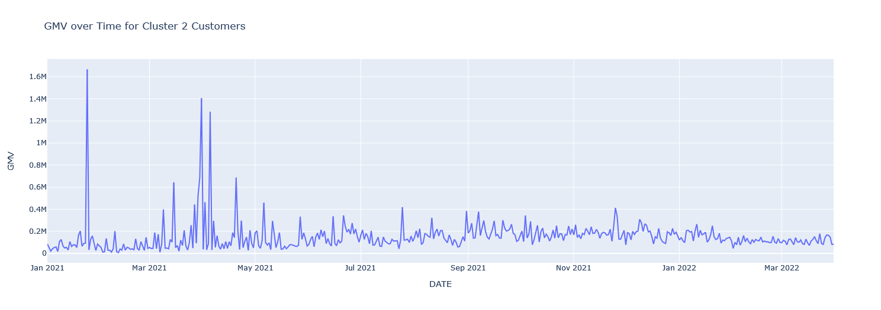
7. Cluster Analysis
7.4. Average monetary value of purchases from users in Clusters
Observations:
Average Monetary Value for Cluster 0: 677.205
Average Monetary Value for Cluster 1: 68.022
Average Monetary Value for Cluster 2: 10.300.165

Slide 24
8. Conclusion
8.1. Summary and Recommendations

Slide 25
Cluster 0
Cluster 1
Cluster 2
Has the highest Average Monetary Value which is ~ 677.205 VND
Users belong in this cluster usually have transactions at Data, Marketplace, Convenient Stores, Supermarket.
Favorite merchants: Viettel, Lazada, Mobifone, Circle K, Tiki.
Average Frequency is 8 & Average Recency is 119.
The least Average Monetary Value which is ~ 52.022.
Users belong in this cluster usually have transactions at Data, Marketplace, Convenient Stores, Coffee chains and Milk tea.
Favorite merchants: Viettel, Lazada, Mobifone, Vinaphone.
Average Frequency is 2 and Average Recency is 178.
They likely to purchase for mobile service
The second highest Average Monetary Value which is ~ 157.749.
Users belong in this cluster usually have transactions at: Marketplace, Data, CVS, Supermarket.
Favorite merchants: Lazada, Viettel, Circle K, Mobiphone, Co.op Mart.
Average Frequency is 69 and Average Recency is 19.
GMV over time significantly increased in Jan, Mar, April
Recommendations:
+ Offer discounts from Data Mobile channels for 4G, Wi-fi.
+ Offer Tiki e-code for Tiki coin exchange.
Recommendations:
Promote vouchers to pay bills monthly:
+ Discount 5.000 VND from 50.000-bill for Internet
+ Discount 5.000 VND from 200.000-bill for Mobile Service
Recommendations:
+ Discount 10.000 VND from 300.000-bill for Electricity
+ Discount Buy 2 get 1 for Highlands
+ Convert Tiki Coin from eGift code

Slide 26
Reference:
An article by Jan Roelf Bult and Tom Wansbeek, titled “Optimal Selection for Direct Mail,” published in a 1995 issue of Marketing Science.
KElbow Visualize
Knee-elbow-point-detection

Slide 27
THANKS !!!
Tên: Phạm Quốc Huy
Mentor: Nguyễn Thị Thắm
Lớp/Nhóm: DA18/Nhóm 2

